Slide 1

IN Specialist Internship Overview – Summer 2023
Hana Younis Joy Maged

Slide 2


Timeline
Over view of the content learned

Slide 3
Timeline
IN introduction
IN Concepts
Load regulation
What is IN? Different Teams?What are mobile networks?
What makes up the IN?
How ae severs and traffic maintained?
IN architecture
Full cycle of a service
Delving deeper into the basic architecture
The integration of the protocols together via real life examples

Slide 4




IN Introduction
1
2
3
4
Teams
Successful Billing
Administration
Planning
Implementation
Support

Slide 5
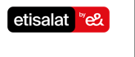
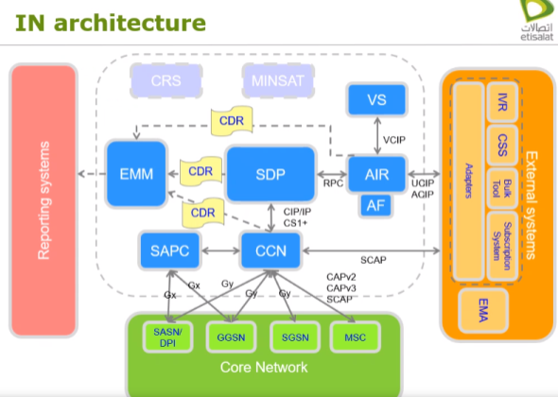
IN Architecture
Keywords covered
SDP
AIR
CCN
OCC
EMM
SAPC
GGSN
UCIP
CIP/IP
Image
Notes:
5. We will talk about UX studio impact, formulation , and expanding its services and impact on other teams

Slide 6


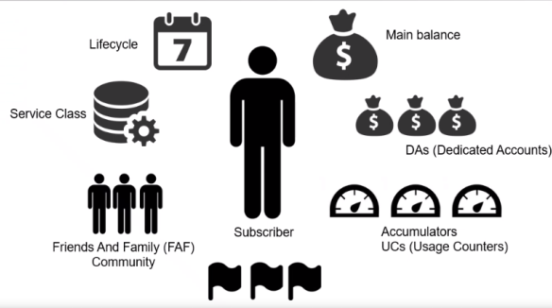






IN Concepts
Lifecycle
Description
Main balance
Description
Service Class
Description
Accumulators
3
Friends and Family (FAF
Description
Description
Subscriber
Dedicated Accounts
Description
Description

Slide 7
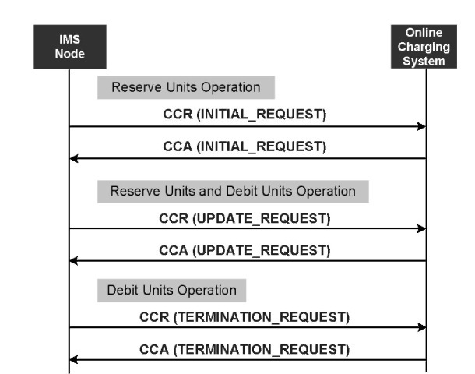
Full cycle of a service
A simulation of a call initializing, updating and termination was discussed using the native Etisalat architecture
Image
Notes:
5. We will talk about UX studio impact, formulation , and expanding its services and impact on other teams

Slide 8
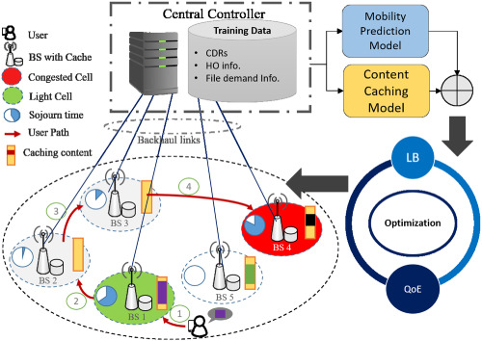
Load balancing
The current load balancing is via local server distributions as well as cloud servers, with timed maintenance and fault detection
Image
Notes:
5. We will talk about UX studio impact, formulation , and expanding its services and impact on other teams

Slide 9
Questions and discussion
Thank you for listening and for your precious time :D

